Slide 1
End 2 End Flow - Scripting
Day 2 - Chapter 3

Slide 2
End 2 End Flow
End 2 End Steps of IndiaOPD – Registered Users Appointment
Launch Page
Login
Search Doctor
Select Date
Click on book appointment
Select time
Enter details and Submit
Click on linked patient
Delete appointment
Sing out

Slide 3
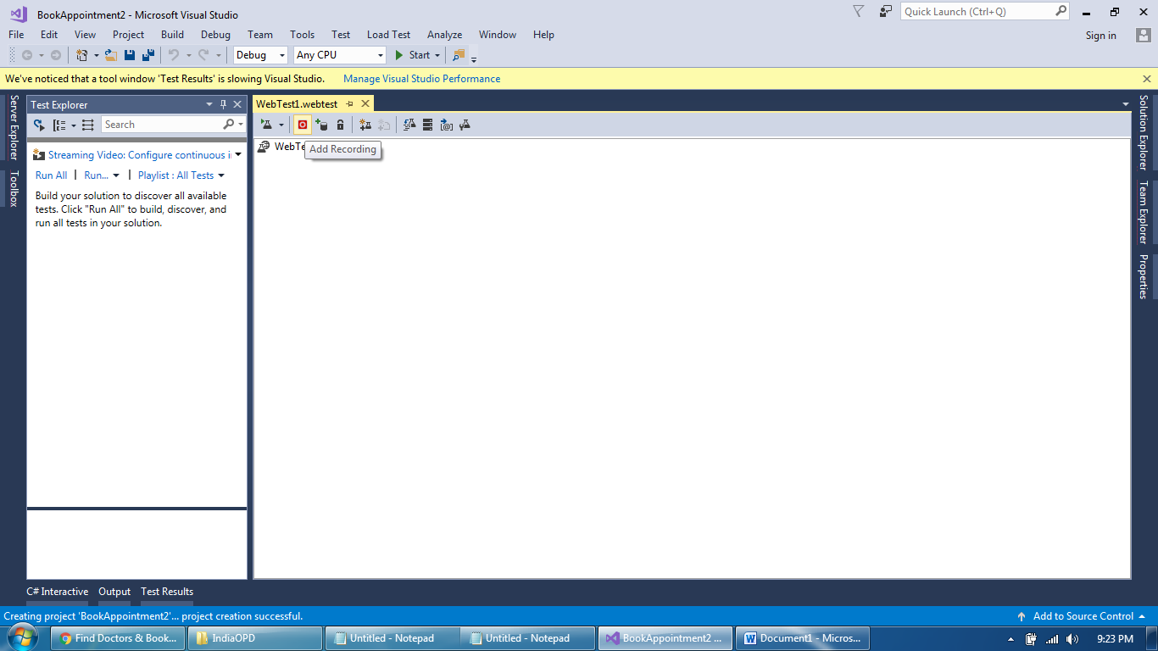
Script Development Screens
How to start Recording

Slide 4
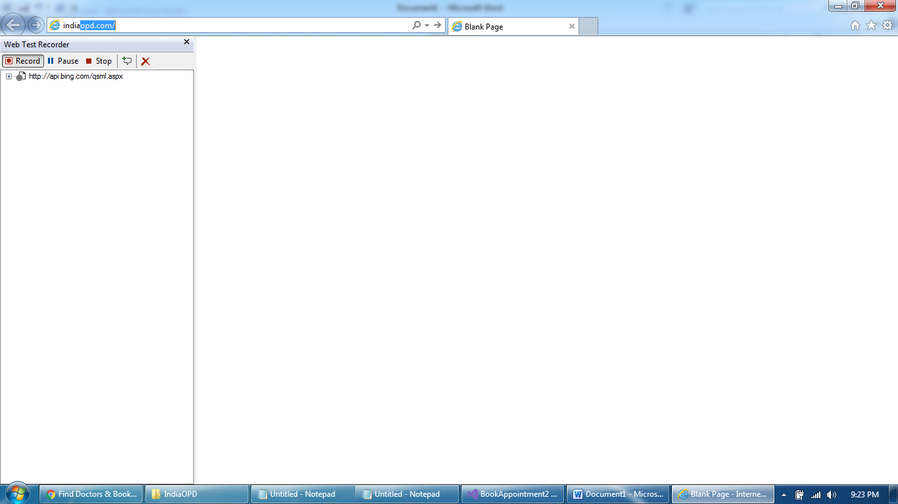
Script Development Screens
Recording started

Slide 5
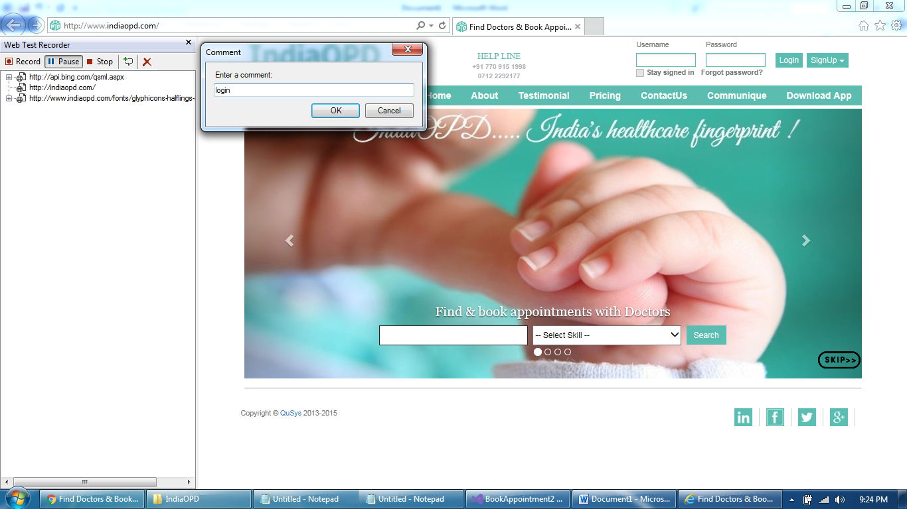
Script Development Screens
Record all steps by adding comments

Slide 6
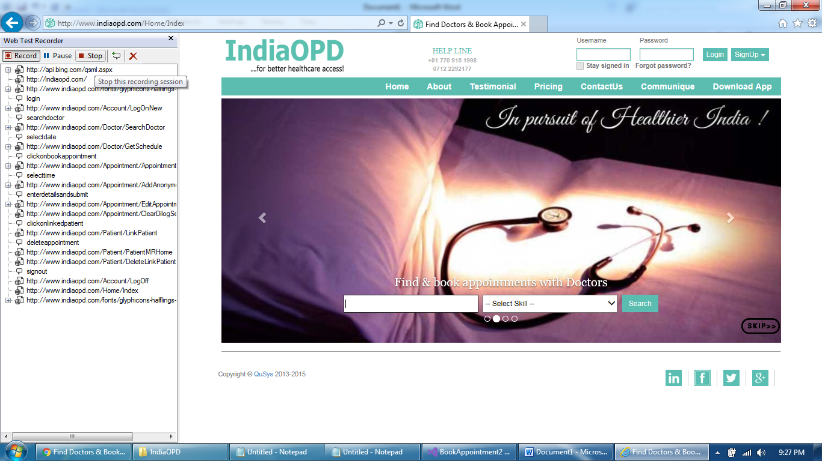
Script Development Screens
Stop Recording once all steps recorded

Slide 7
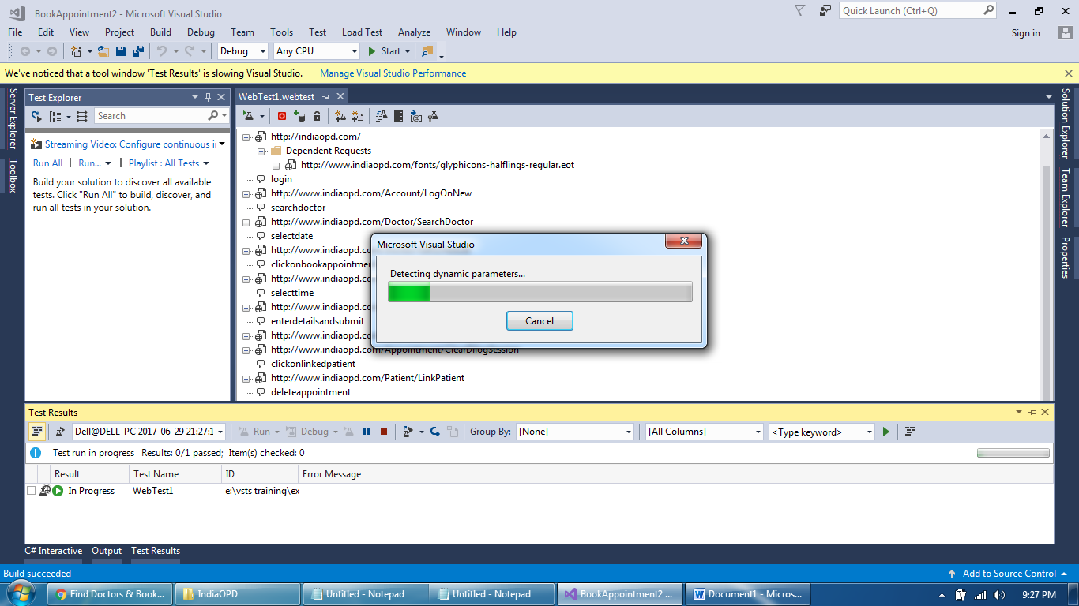
Script Development Screens
Script Recorded and Detecting Dynamic Parameters

Slide 8
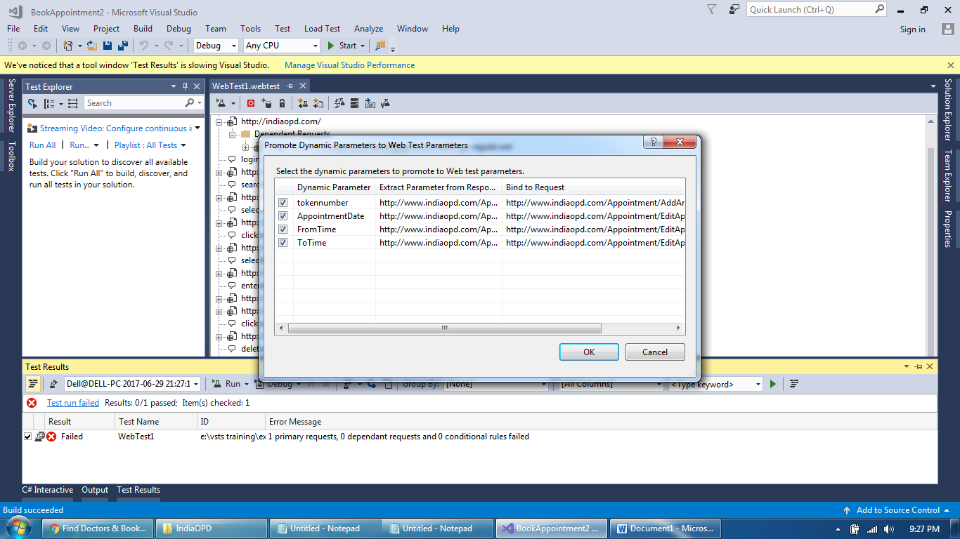
Script Development Screens
Promote Already Captured Dynamic Parameters

Slide 9
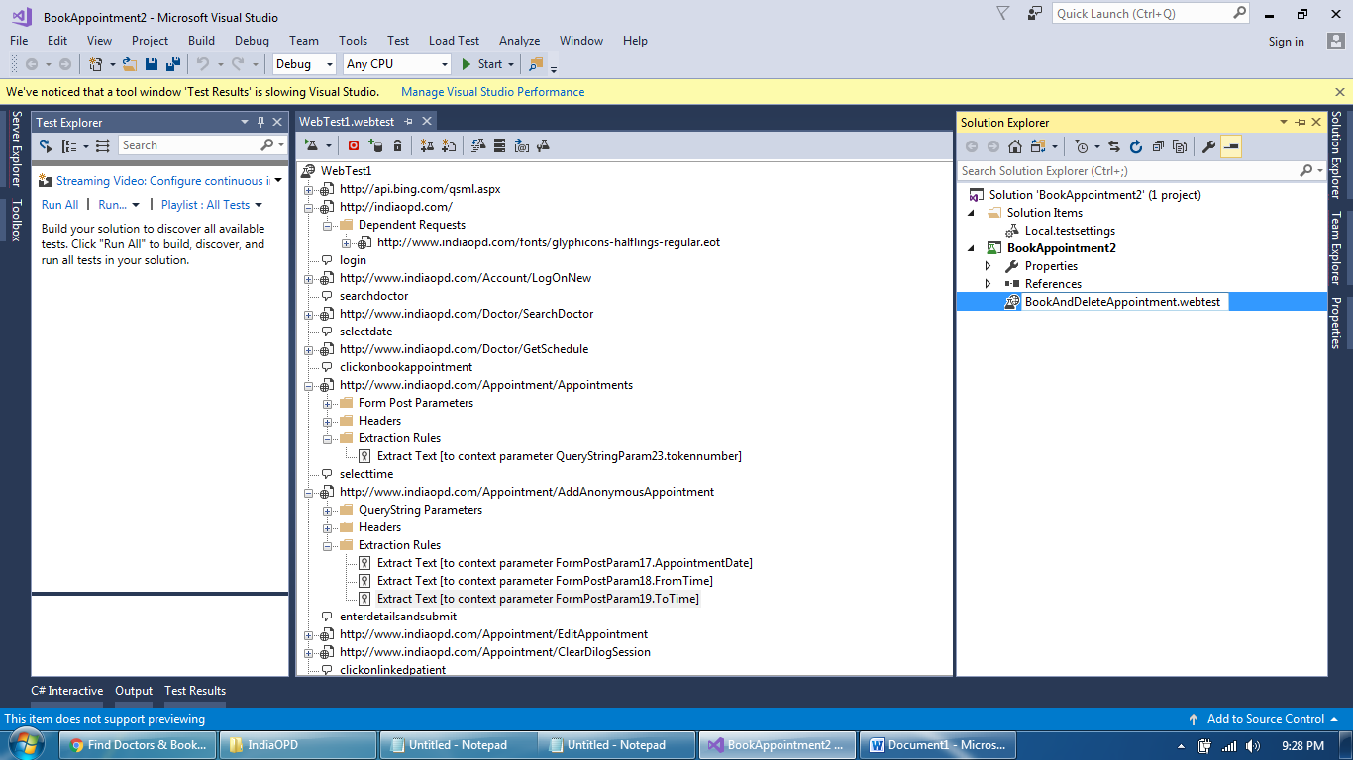
Script Development Screens
Extraction Rules of Dynamically captured Parameters

Slide 10
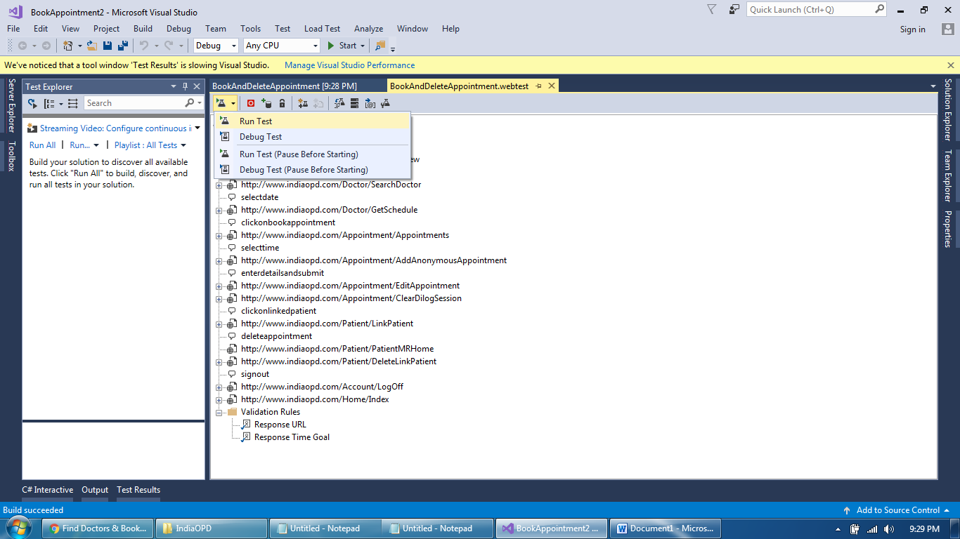
Script Development Screens
Run a script

Slide 11
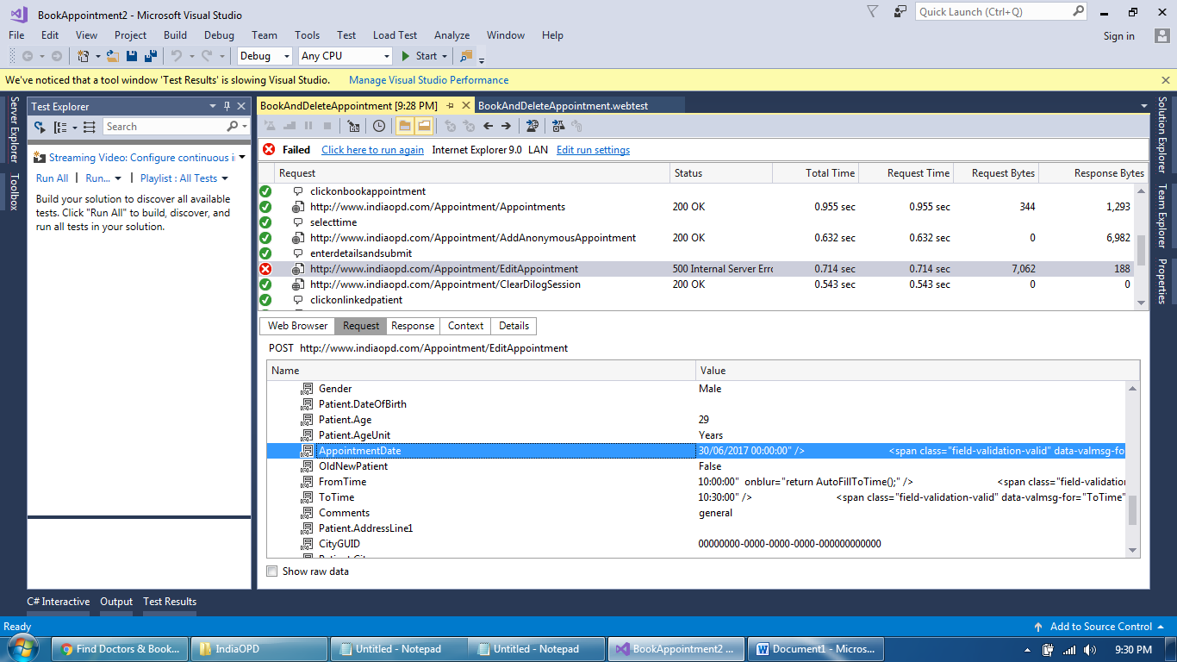
Script Development Screens
Script failed – Wrongly captured Dynamic value

Slide 12
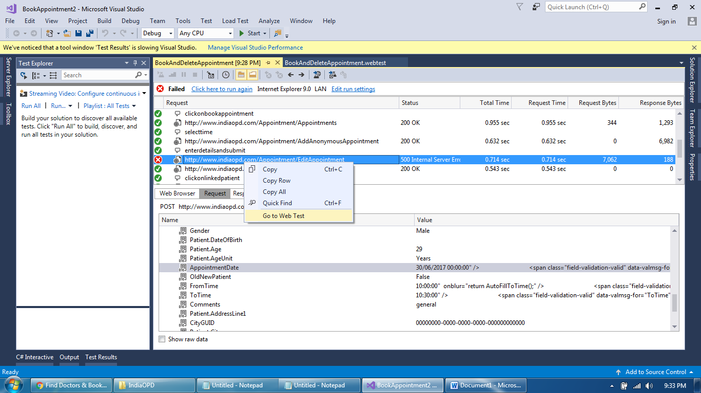
Script Development Screens
Select Failed Request and go to Web Test

Slide 13
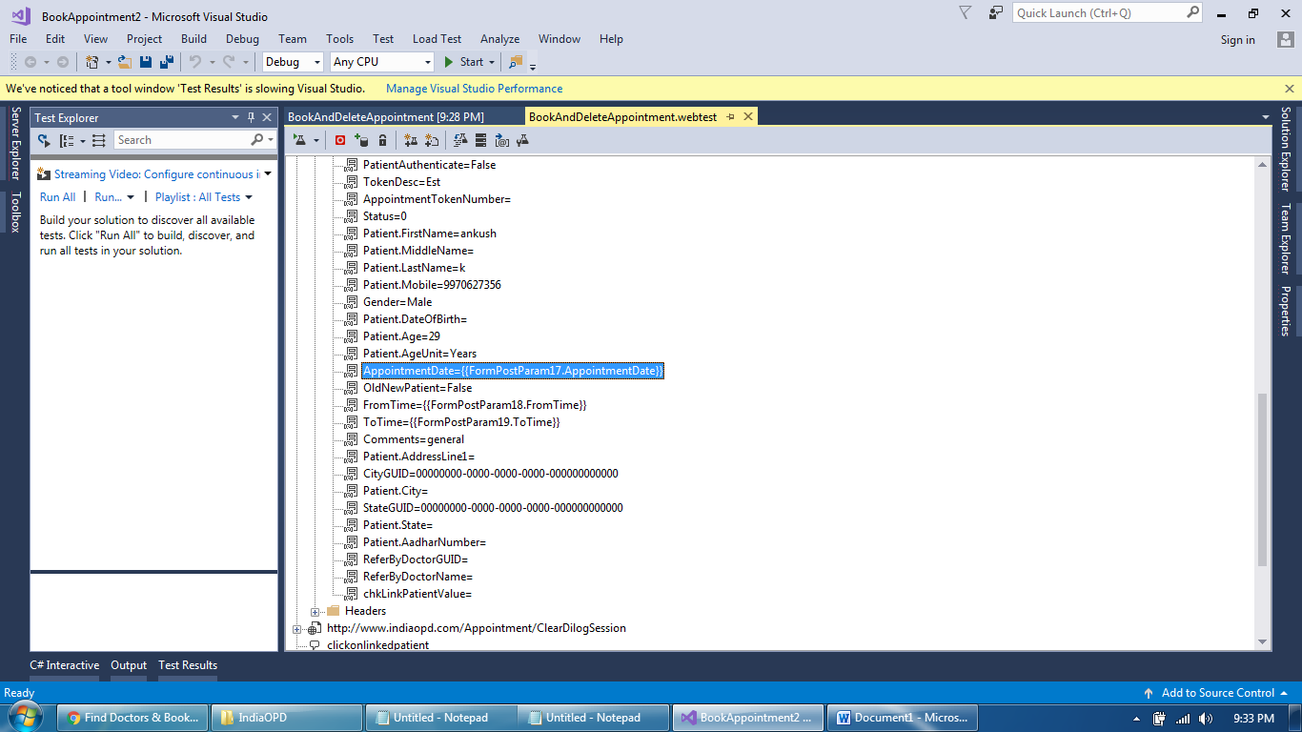
Script Development Screens
Locate the Parameter Name

Slide 14
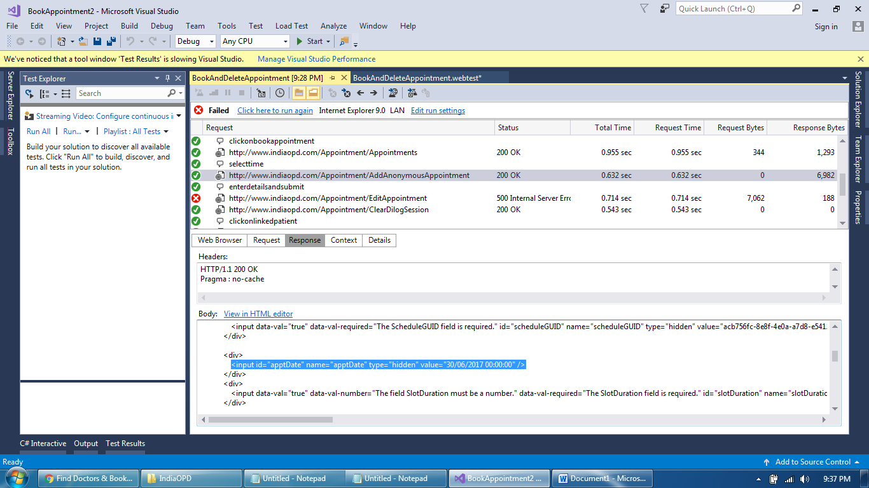
Script Development Screens
Locate the original response and value

Slide 15
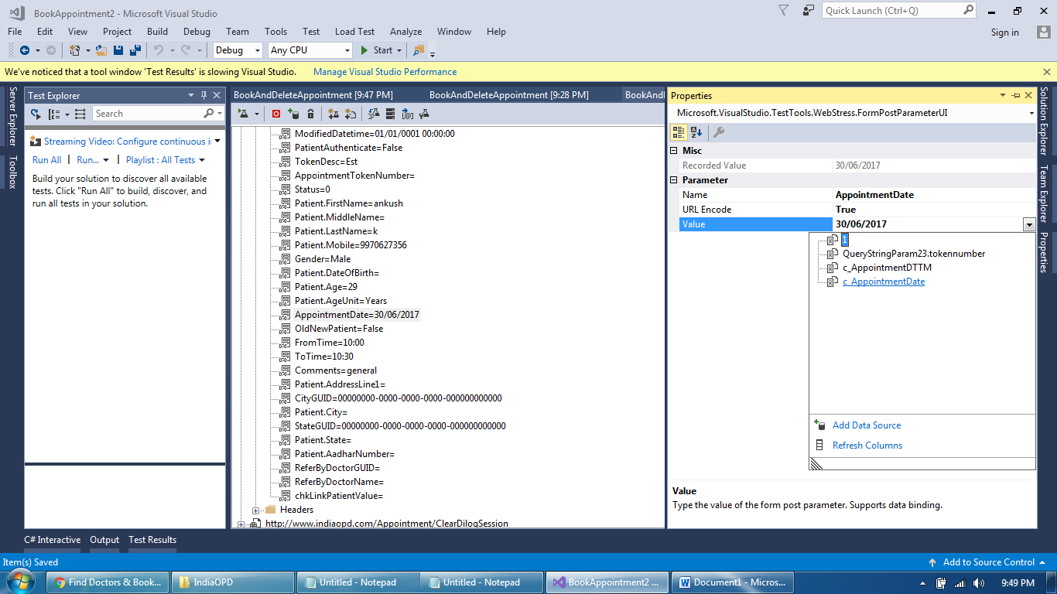
Script Development Screens
Replace parameter value with newly added extraction rule

Slide 16
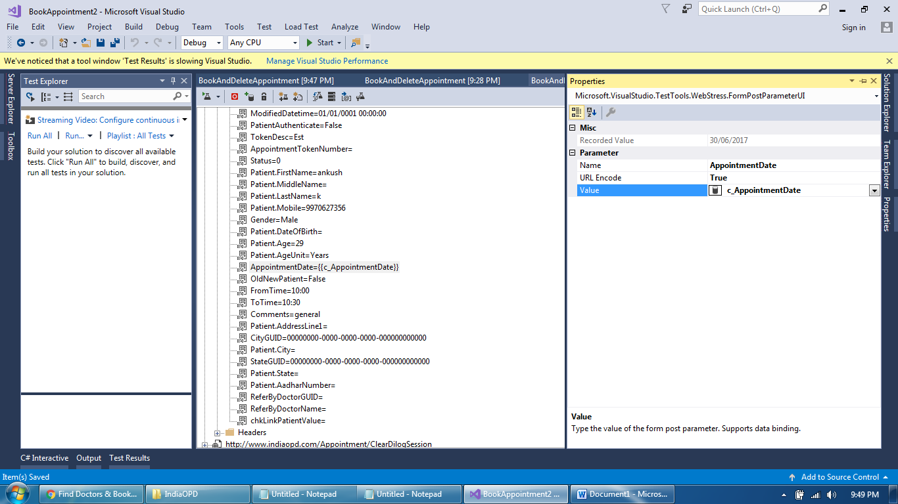
Script Development Screens
Value replaced

Slide 17
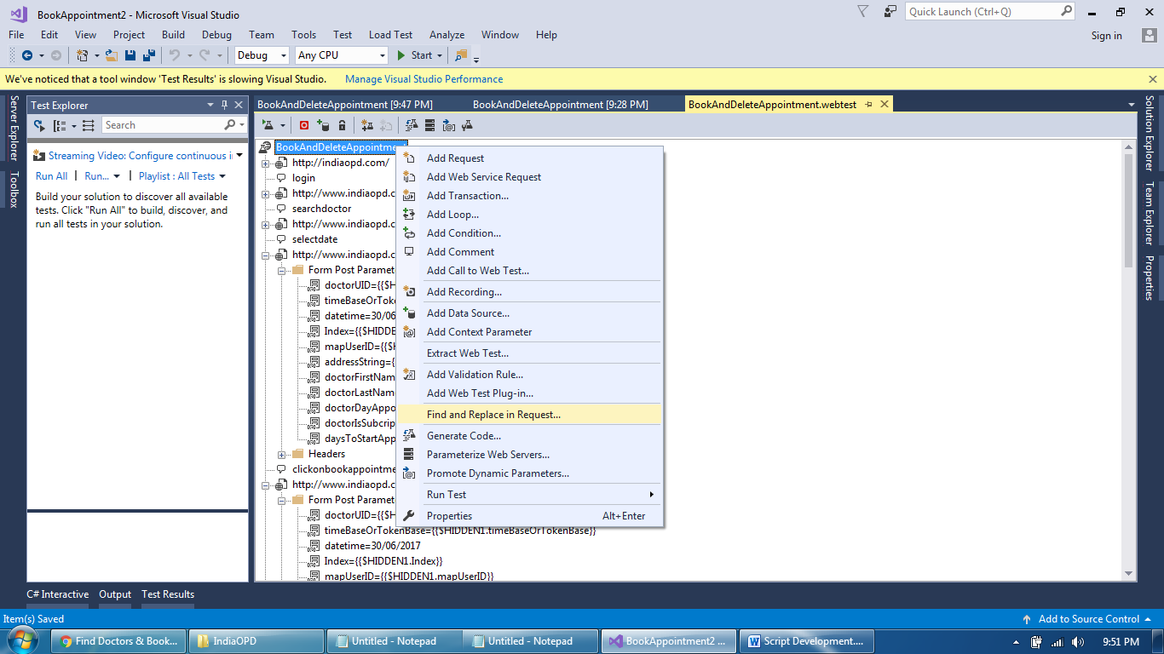
Script Development Screens
Find and Replace all other similar values in next requests

Slide 18
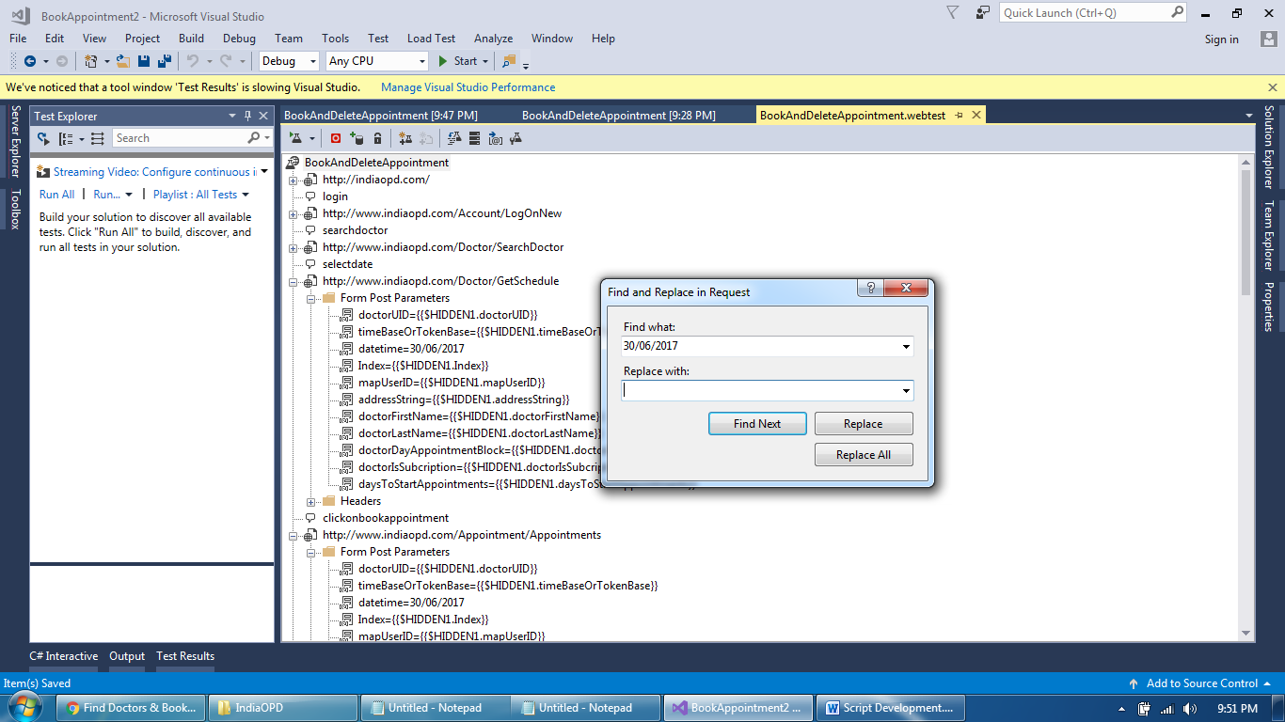
Script Development Screens
Value replaced

Slide 19
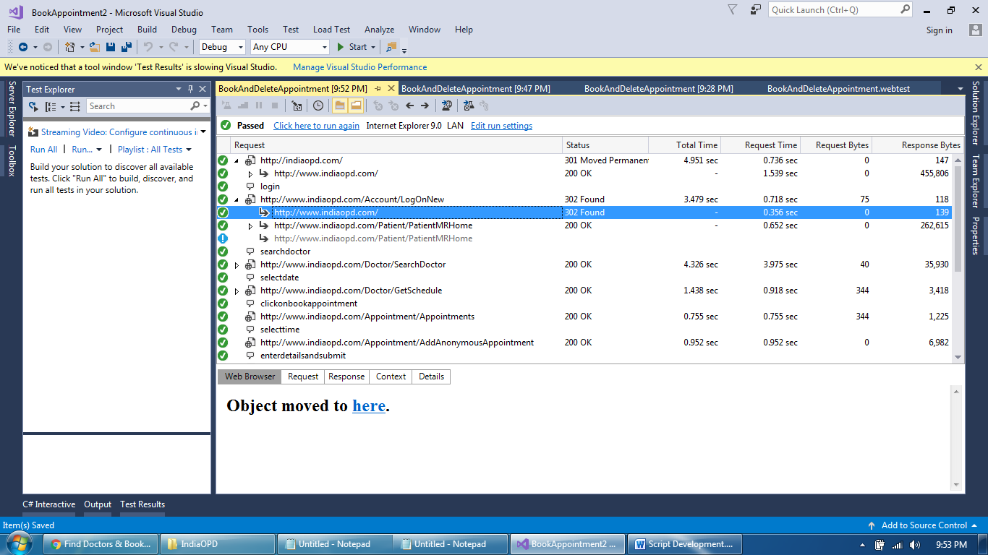
Script Development Screens
Script Run passed

Slide 20
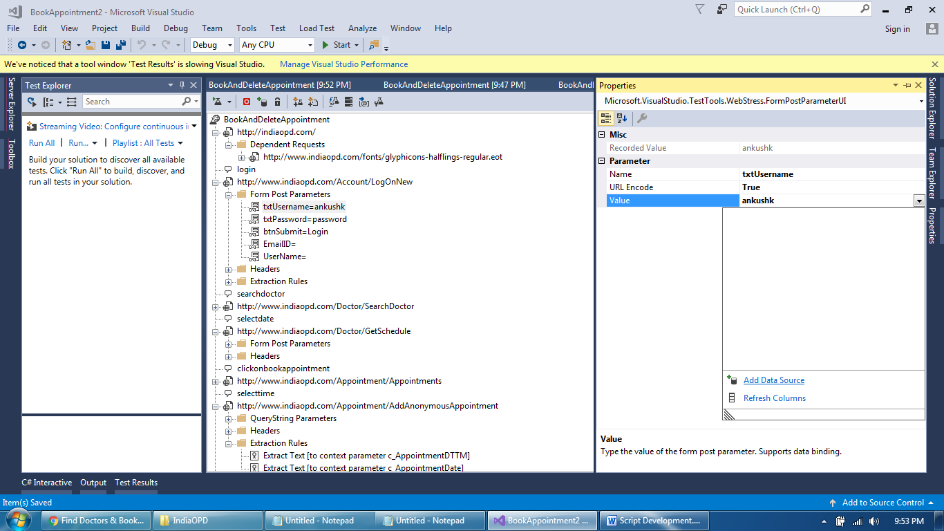
Script Development Screens
Parameterize the data – Data Binding

Slide 21
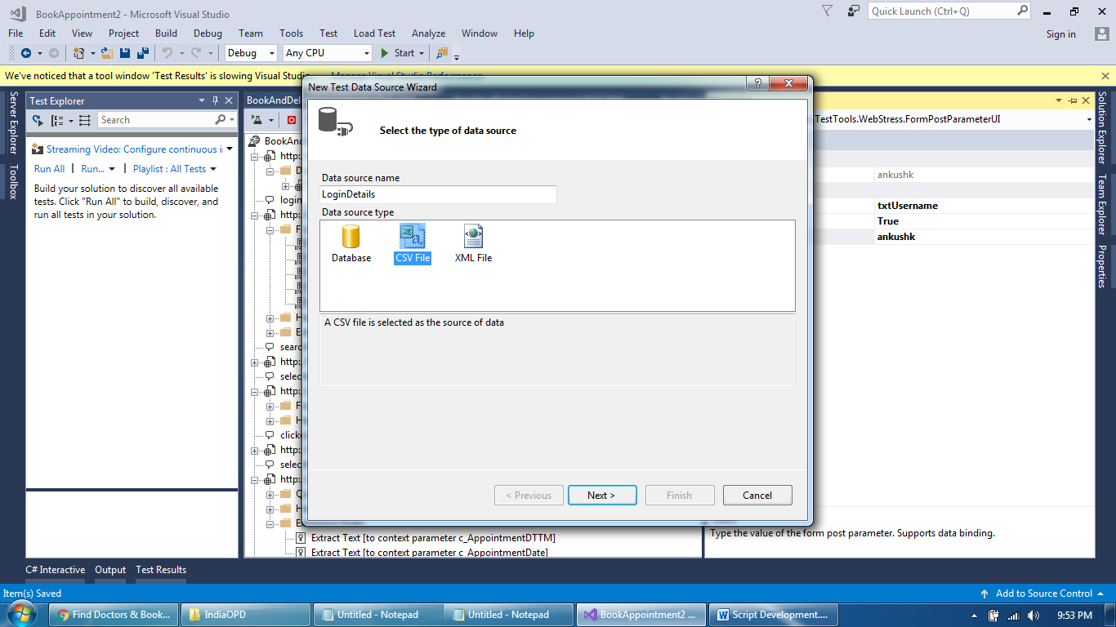
Script Development Screens
Parameterize the data – Data Binding

Slide 22
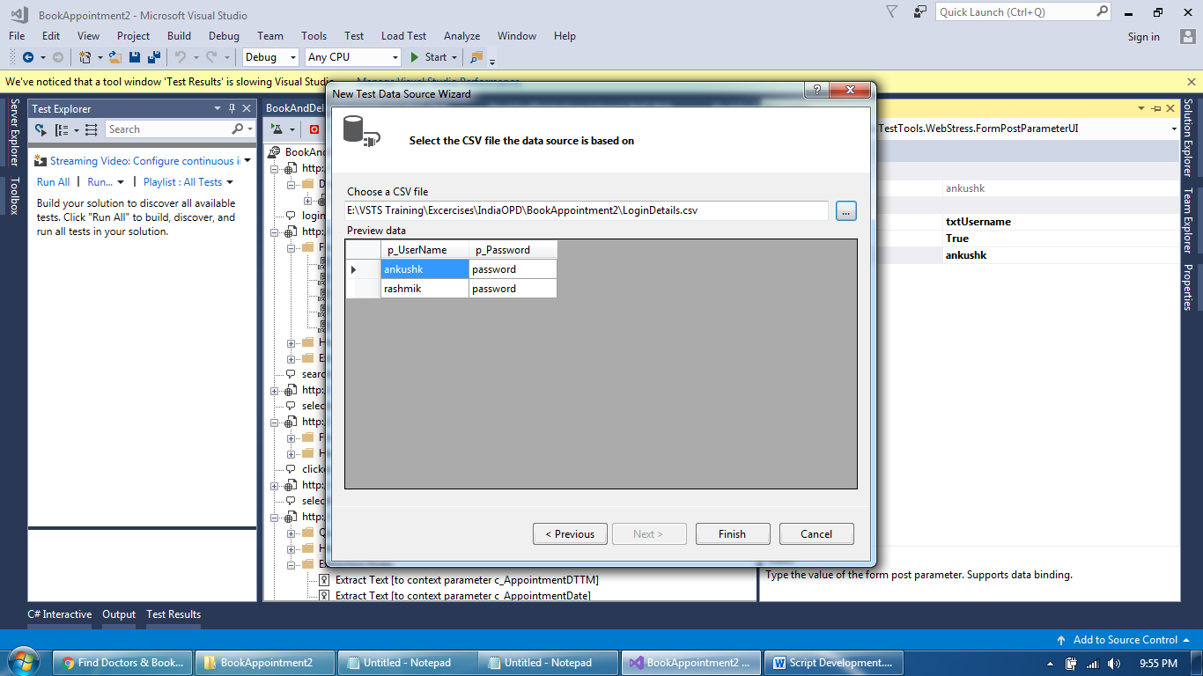
Script Development Screens
Provide Path to CSV file and verify data with parameter names

Slide 23
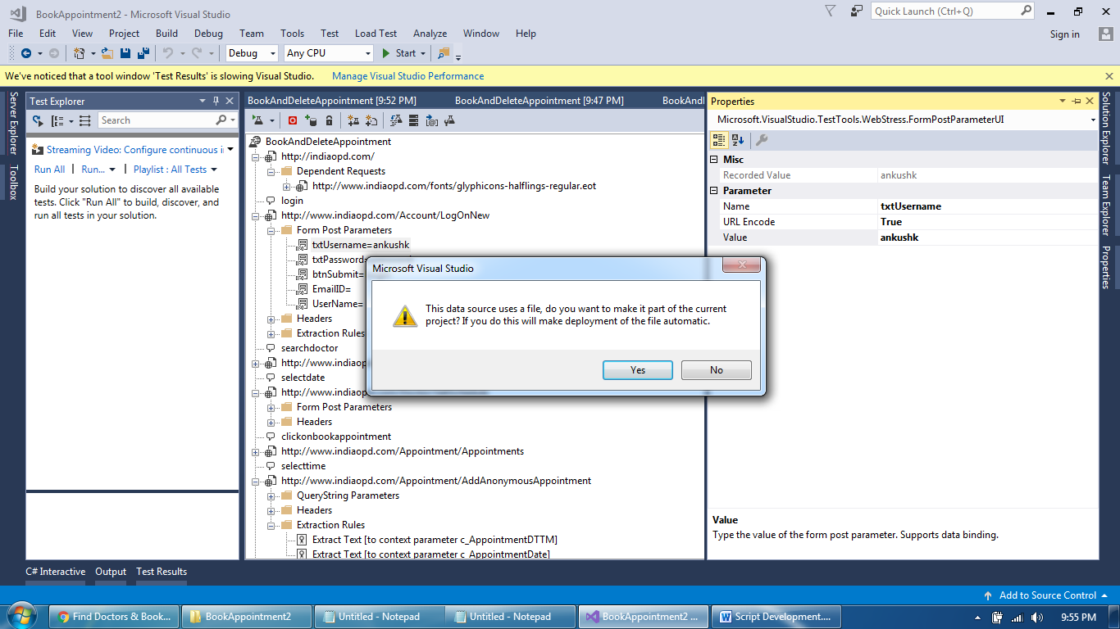
Script Development Screens
Keep copy of CSV file within script folder location

Slide 24
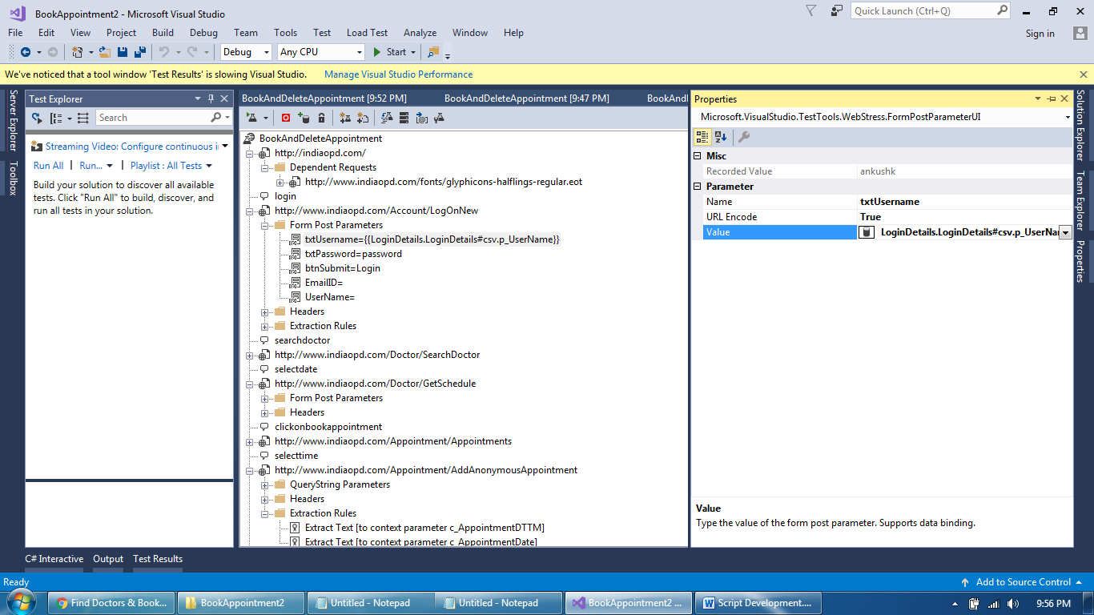
Script Development Screens
Data Binding completed

Slide 25
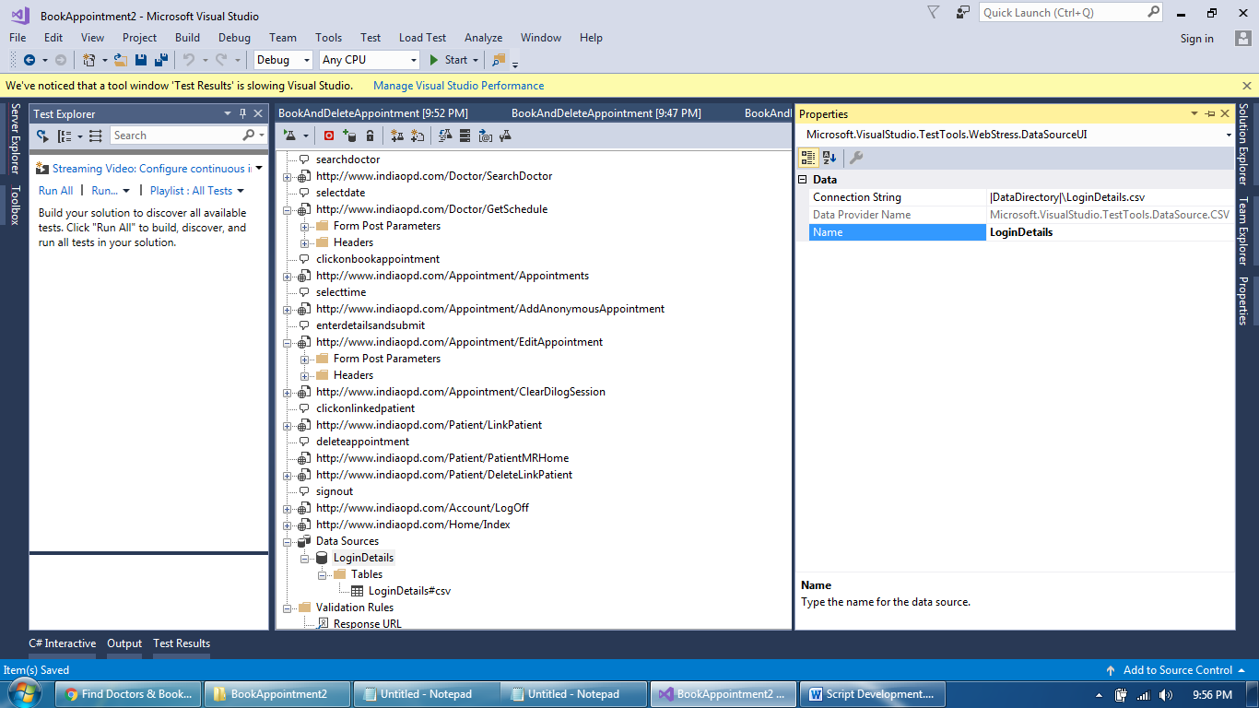
Script Development Screens
Data Source Added

Slide 26
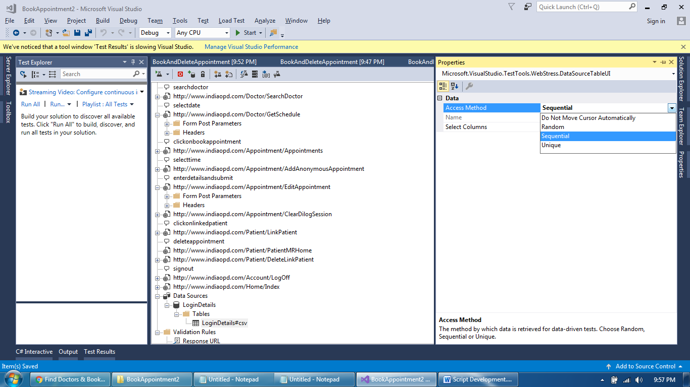
Script Development Screens
Data Source Property

Slide 27
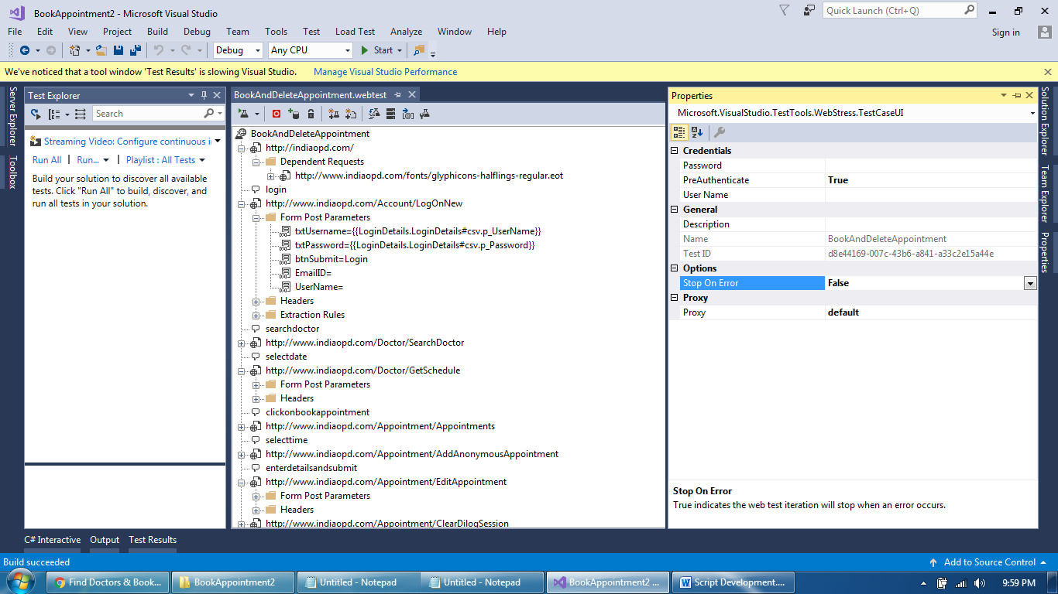
Script Development Screens
Script Properties

Slide 28
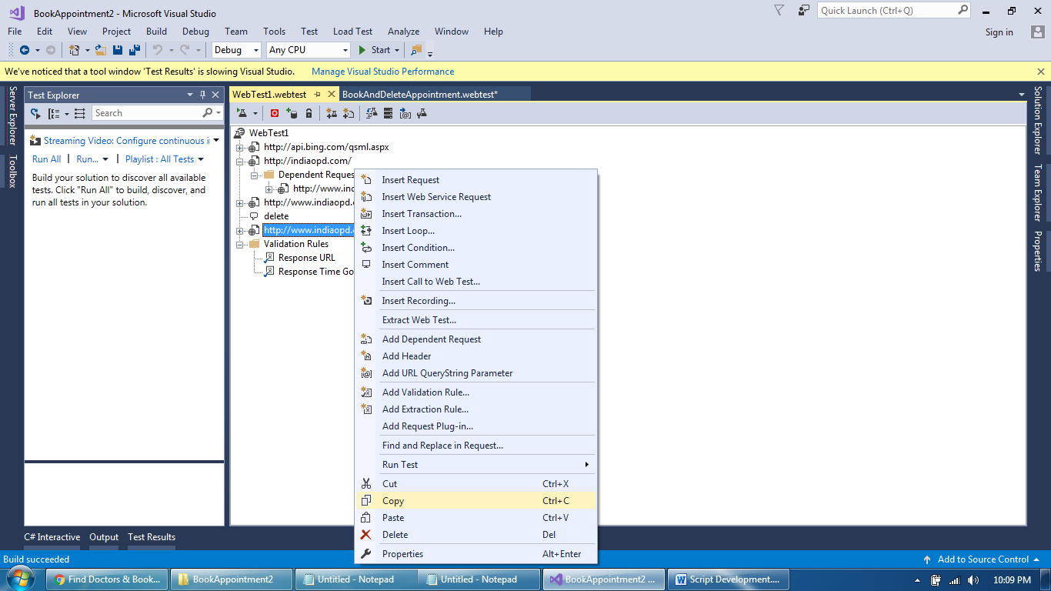
Script Development Screens
How to add new request to existing script – copy new request

Slide 29
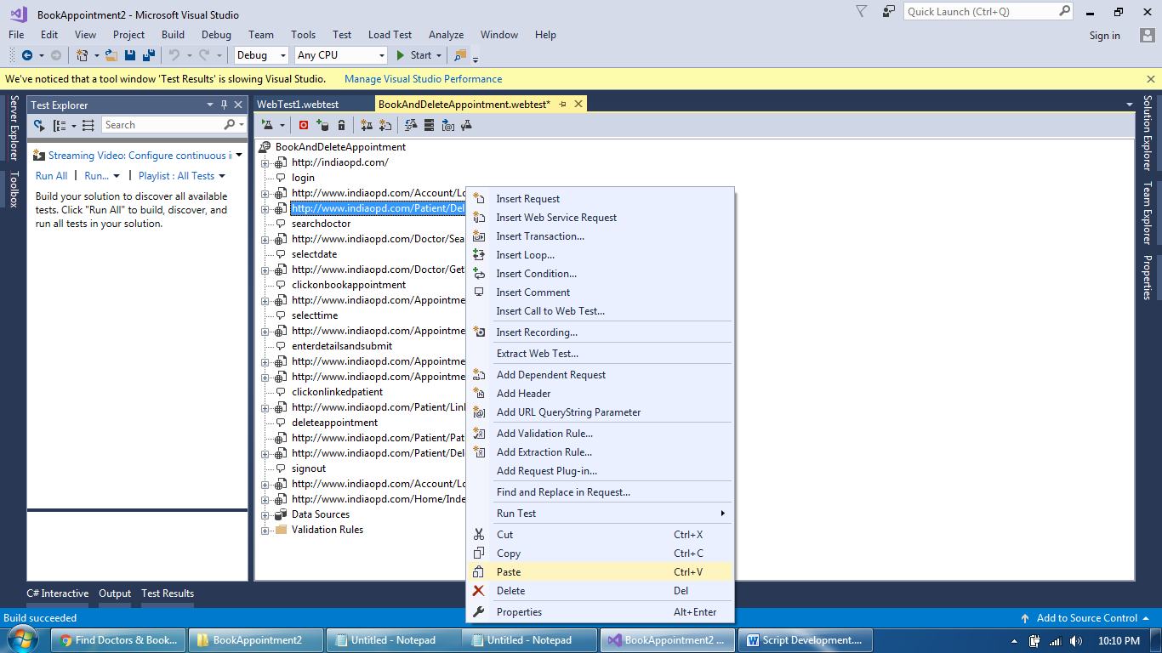
Script Development Screens
Paste wherever you want

Slide 30
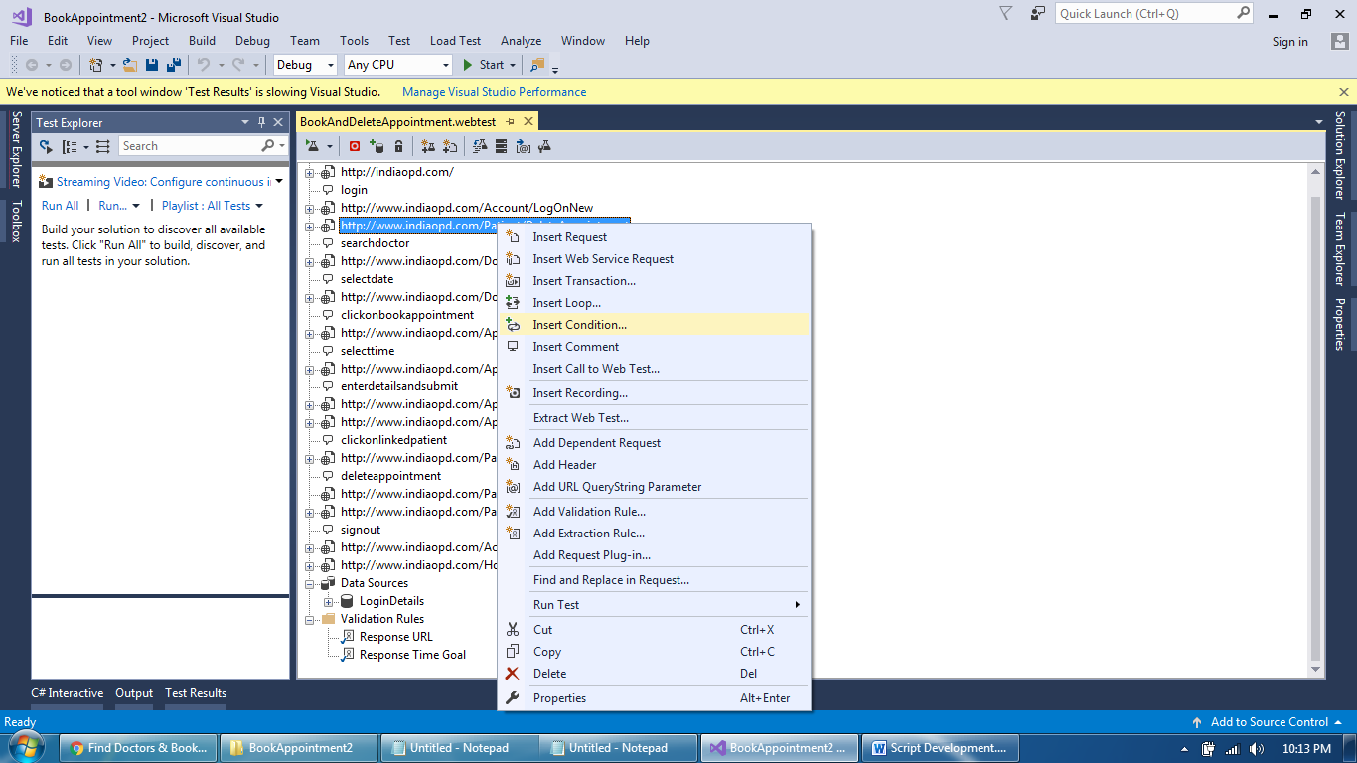
Script Development Screens
Conditional execution of request

Slide 31
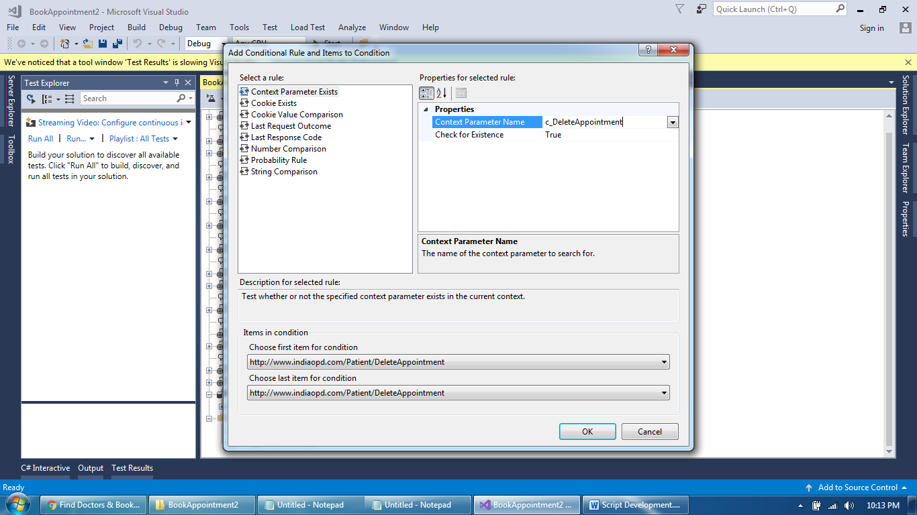
Script Development Screens
Conditional execution of request

Slide 32
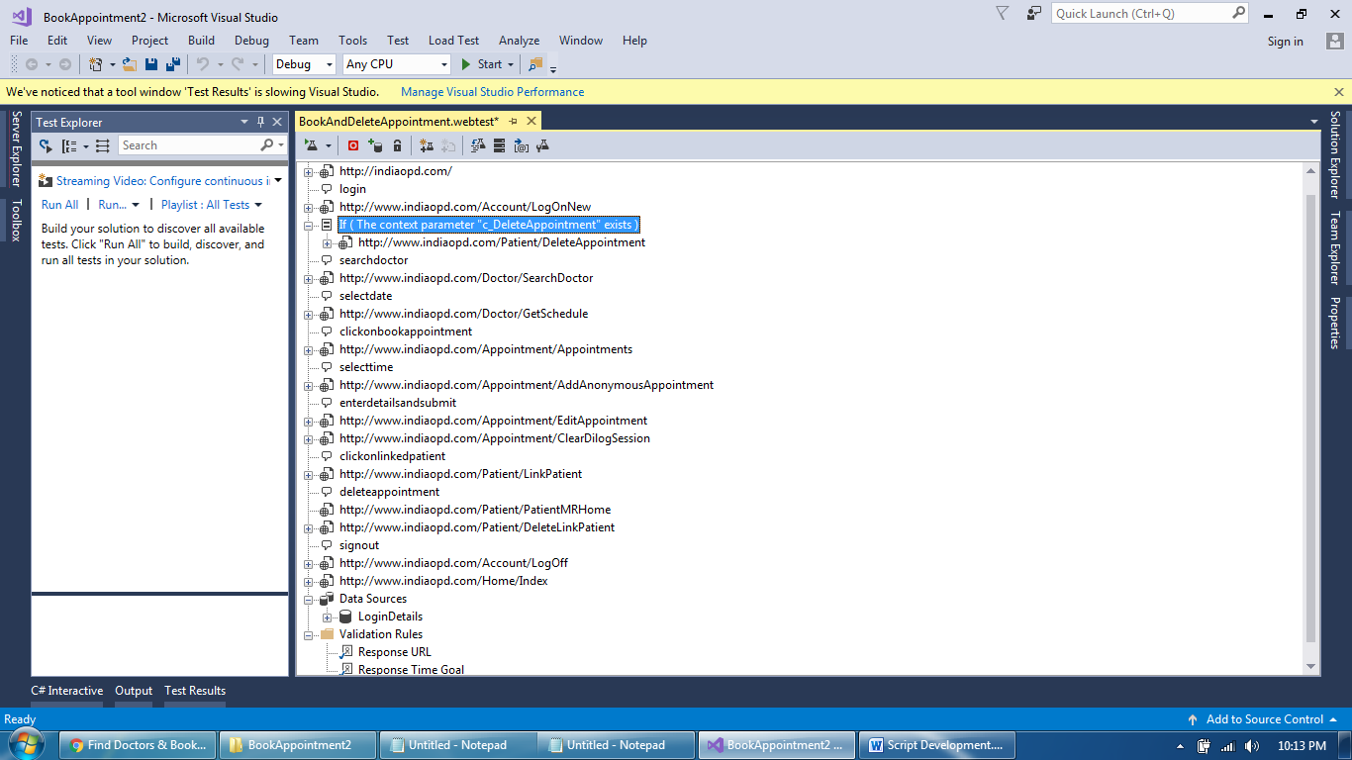
Script Development Screens
Conditional execution of request

Slide 33
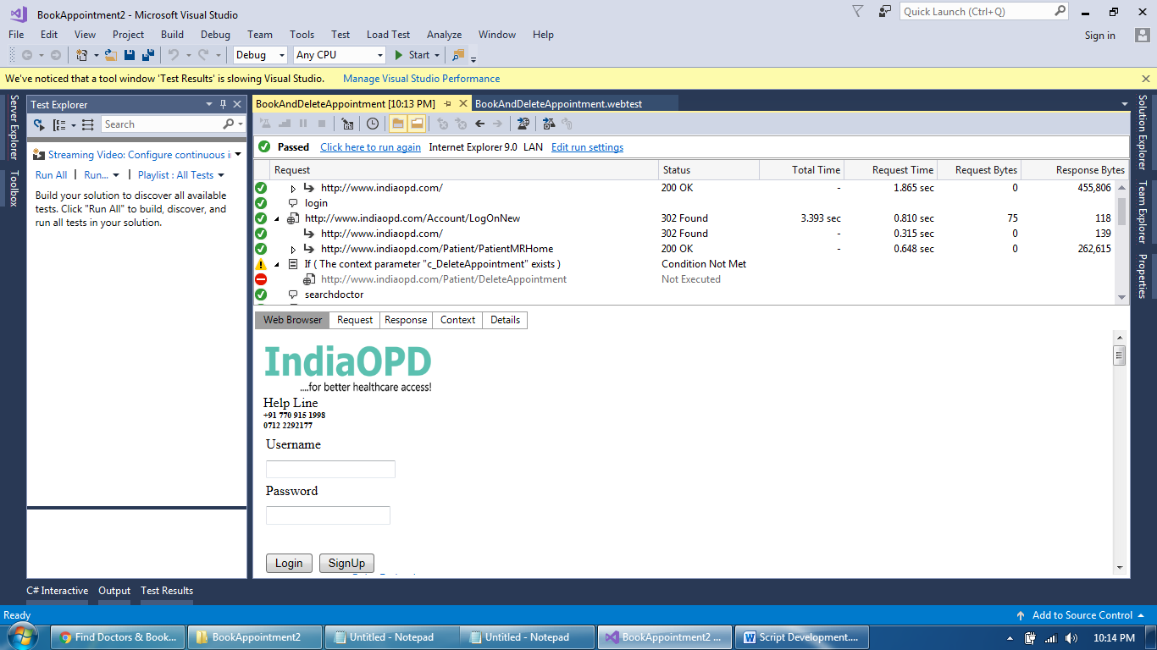
Script Development Screens
Conditional execution of request

Slide 34
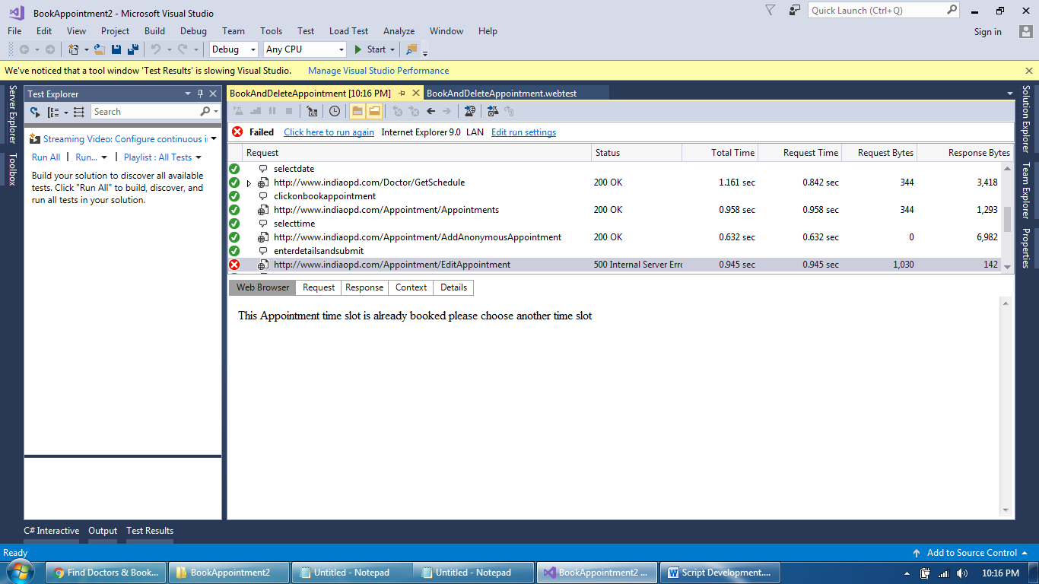
Script Development Screens
Script failed due to destructive data – appointment date

Slide 35
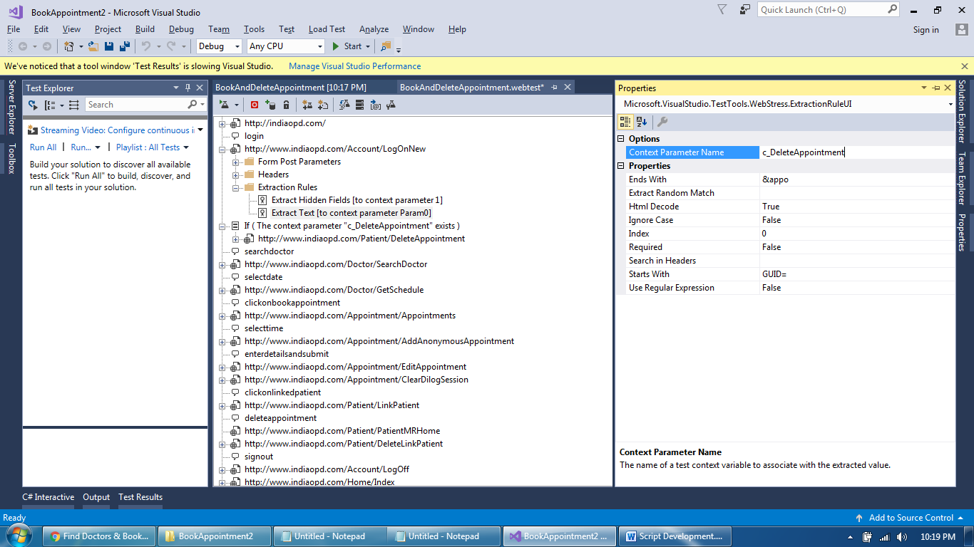
Script Development Screens
Capture value of destructive data to delete it upon “condition”

Slide 36
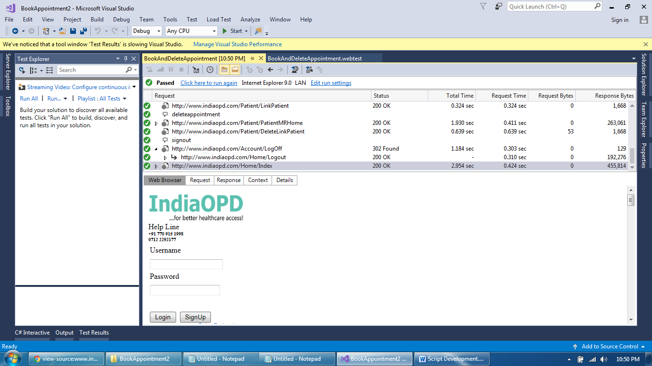
Script Development Screens
Script passed after deleting destructive data

Slide 37
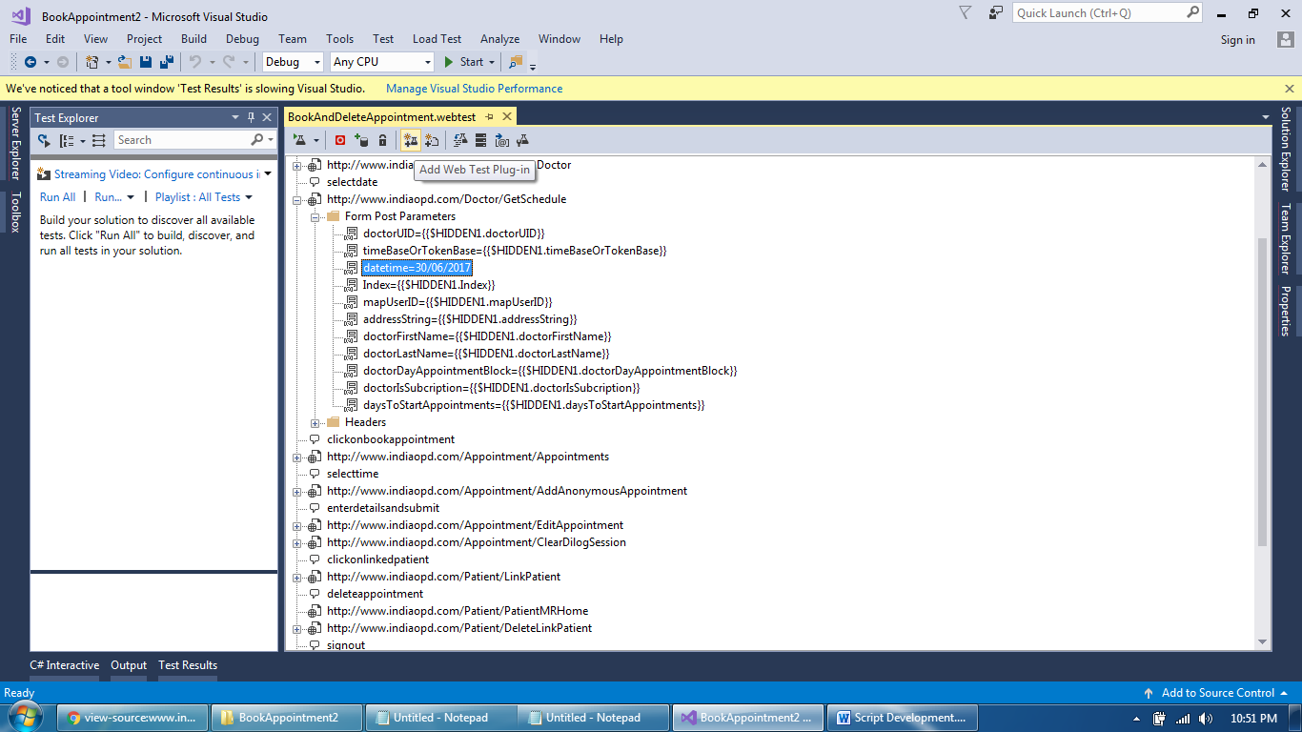
Script Development Screens
Identify and bind the data entered by user

Slide 38
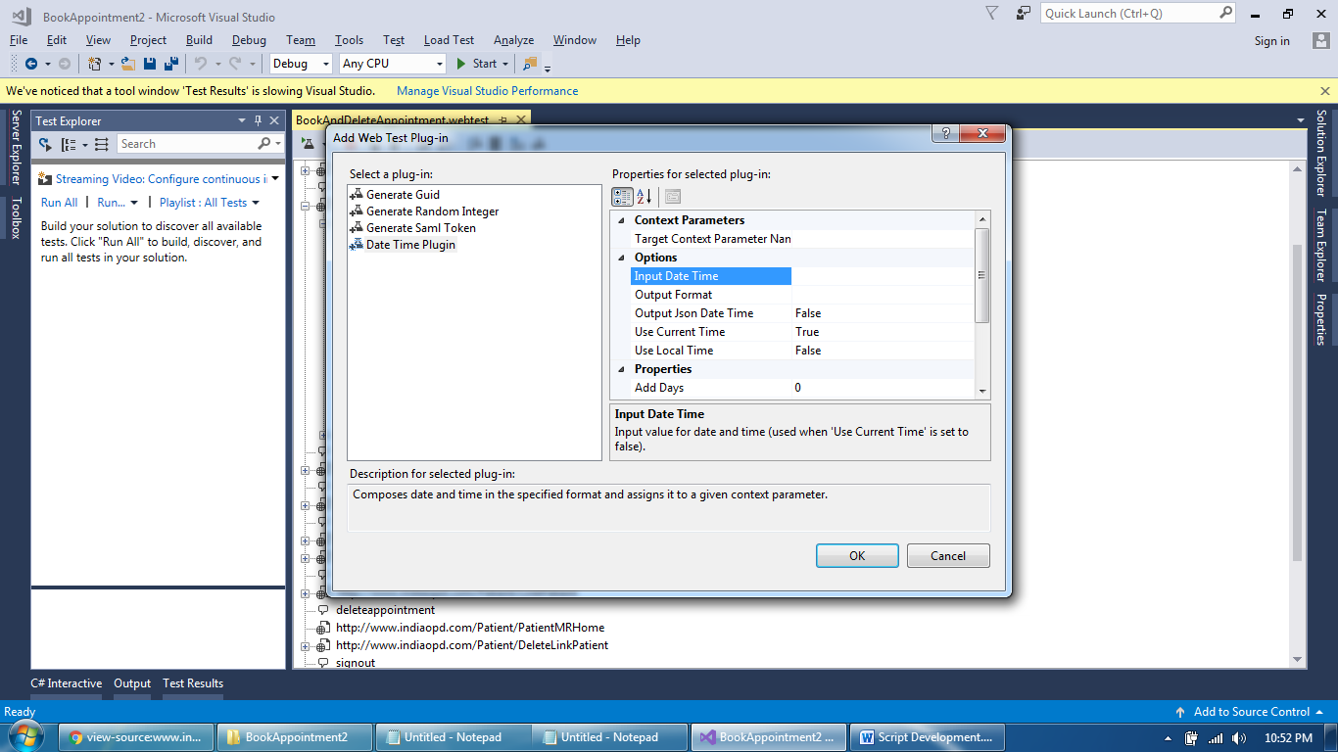
Script Development Screens
Add web test plugin and select appropriate plugin type

Slide 39
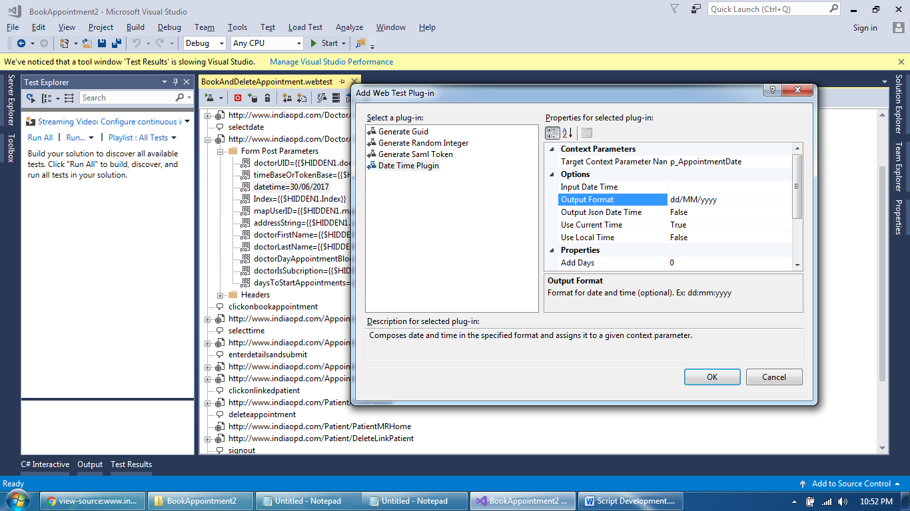
Script Development Screens
Select Appropriate format (e.g. / or : between date and month)

Slide 40
Script Development Screens
Select Appropriate format (e.g. / or : between date and month)

Slide 41
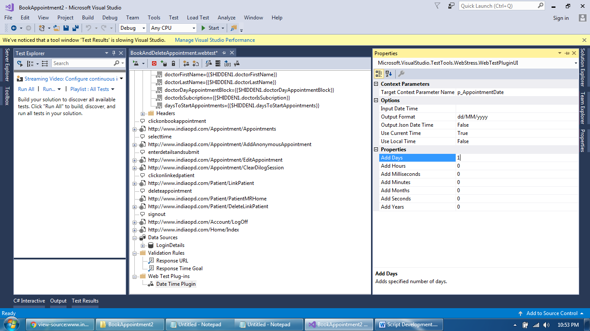
Script Development Screens
Select Appropriate condition

Slide 42
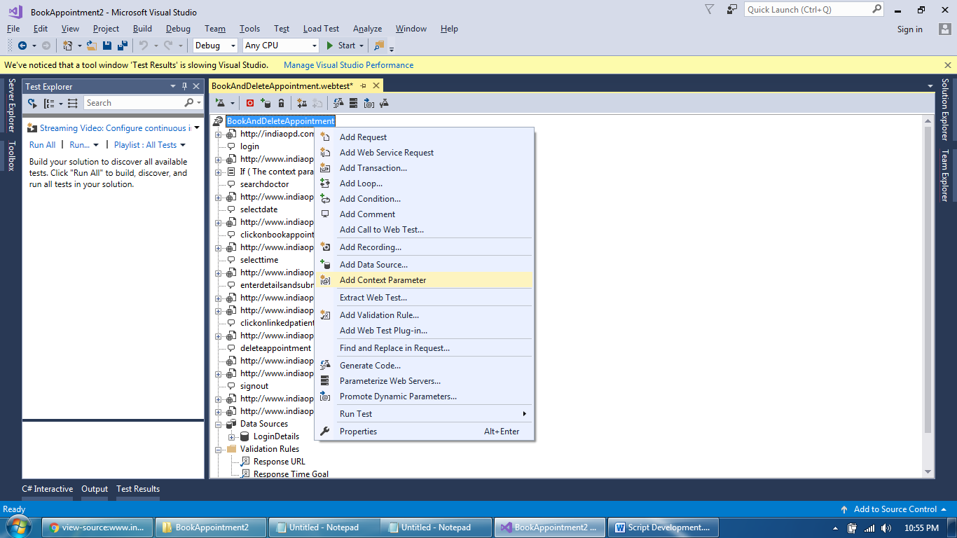
Script Development Screens
Add Context Parameter to store web test plugin value

Slide 43
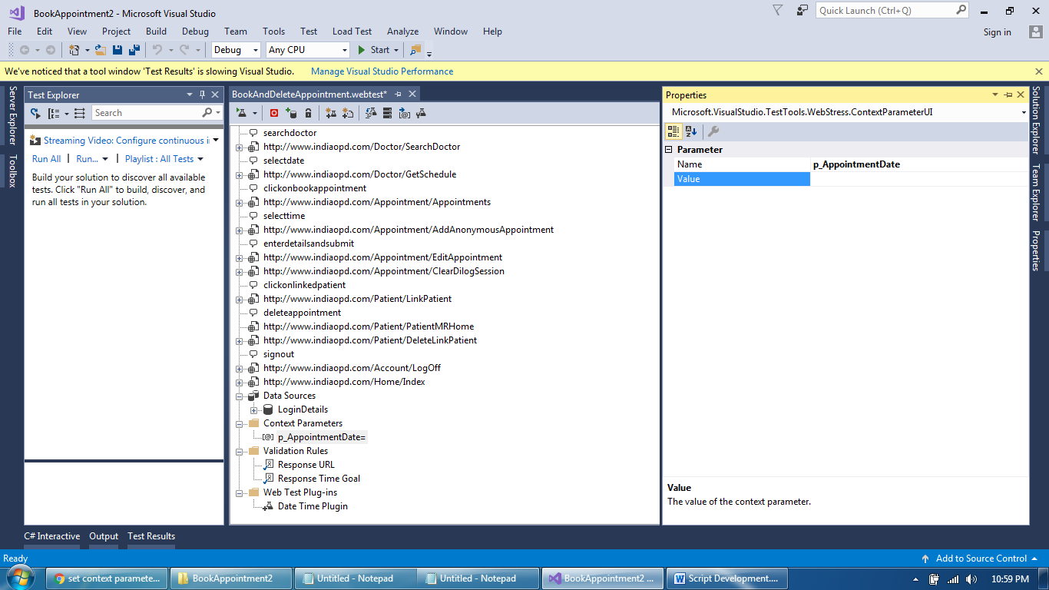
Script Development Screens
Parameter Name should be exactly same and value empty

Slide 44
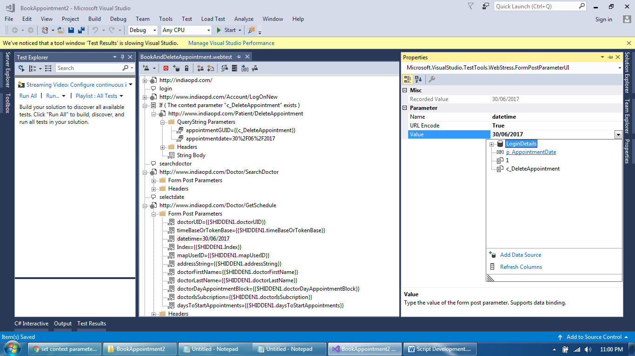
Script Development Screens
Replace the actual value with parameter

Slide 45
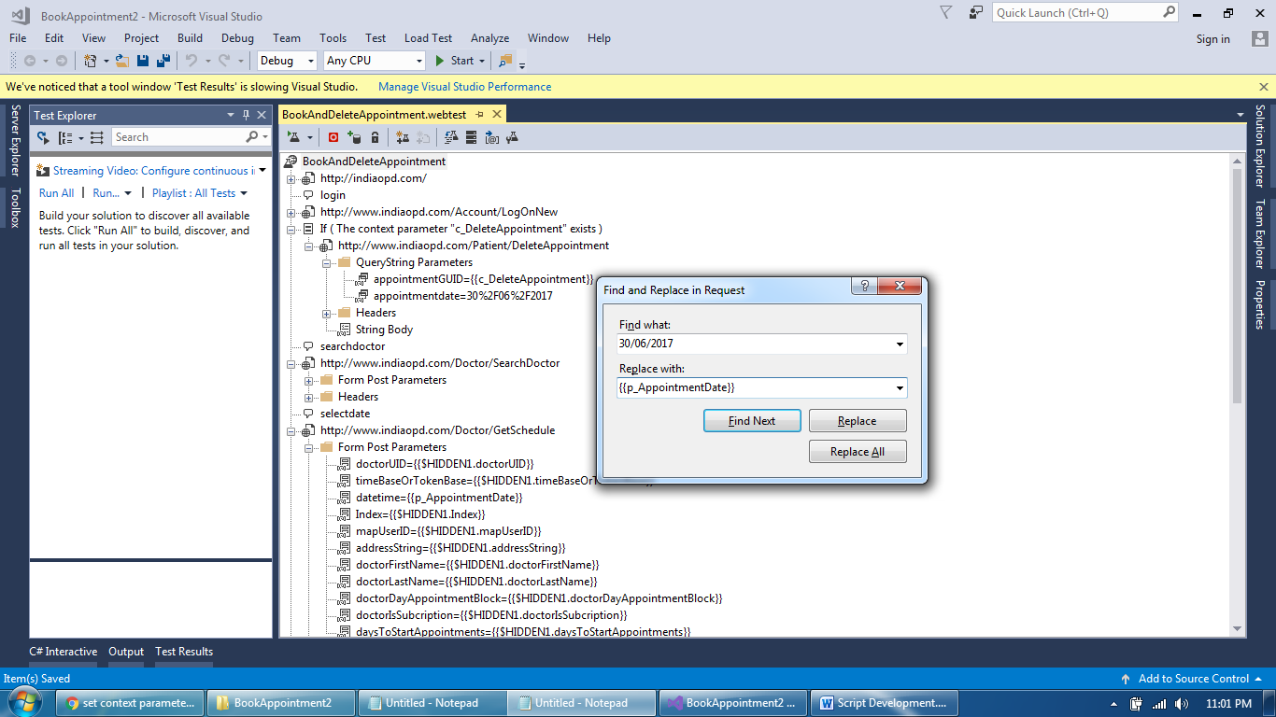
Script Development Screens
Find and replace all other occurrences of values

Slide 46
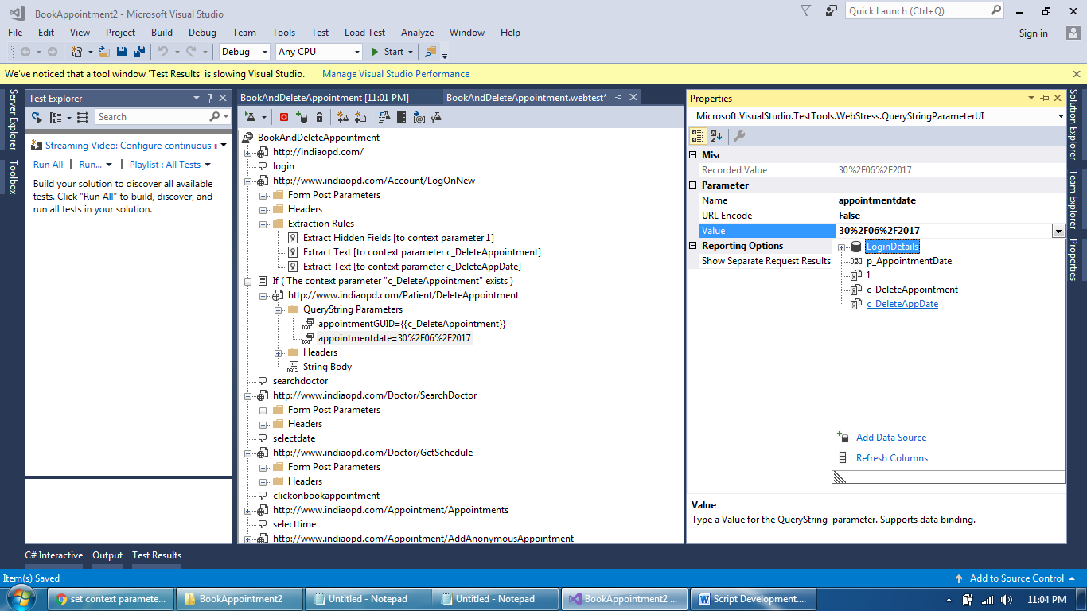
Script Development Screens
Replace one more value at delete appointment

Slide 47
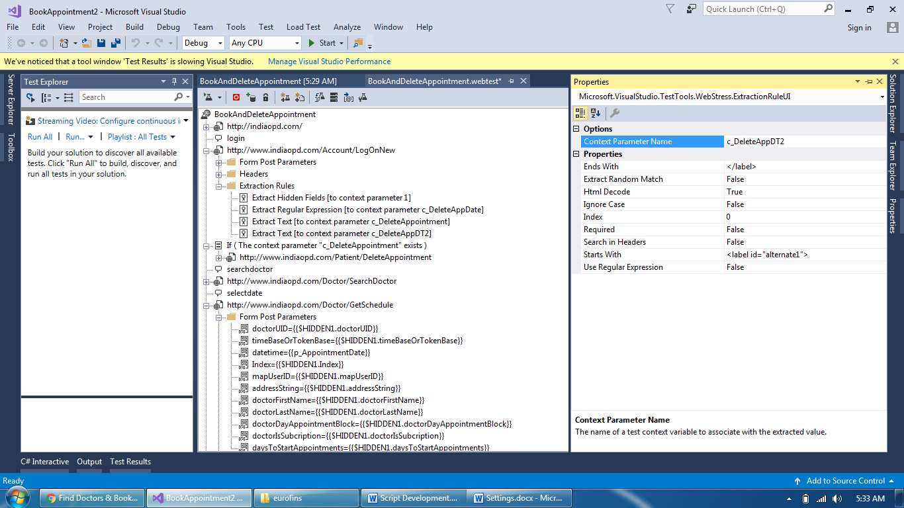
Script Development Screens
Exact extraction rule for appointment date at delete

Slide 48
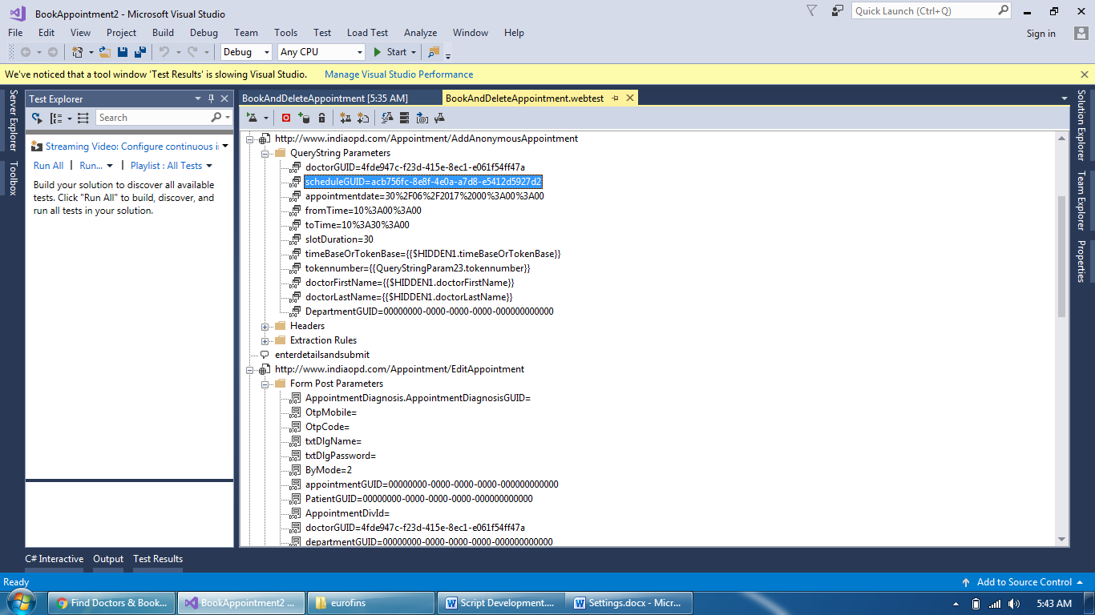
Script Development Screens
How to capture group of dependent values in extraction

Slide 49
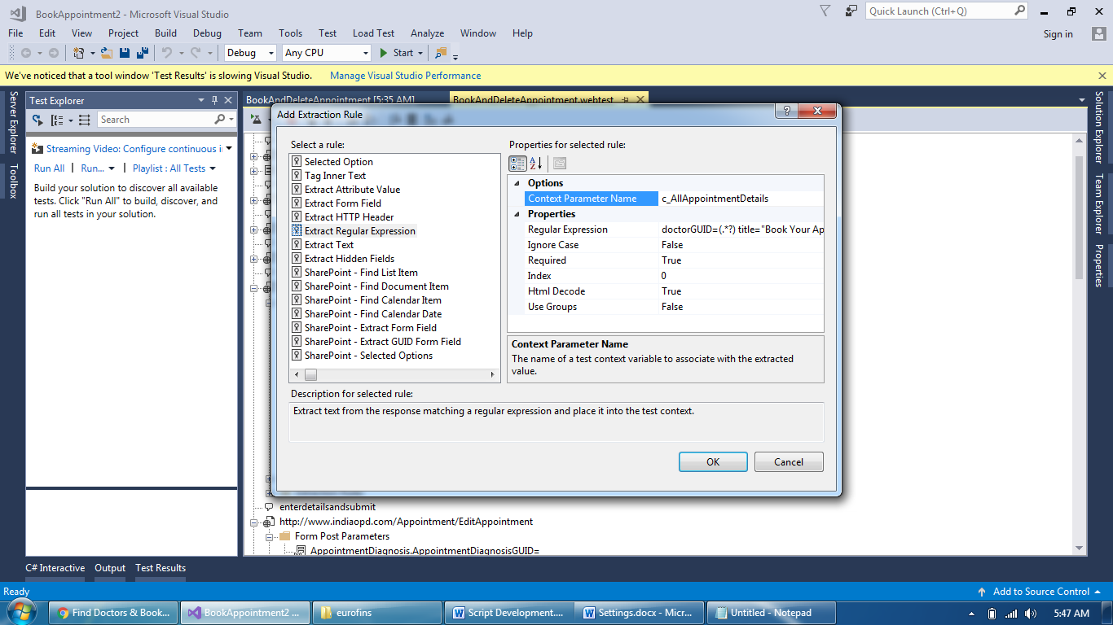
Script Development Screens
Locate and capture entire row of values using RegEx

Slide 50
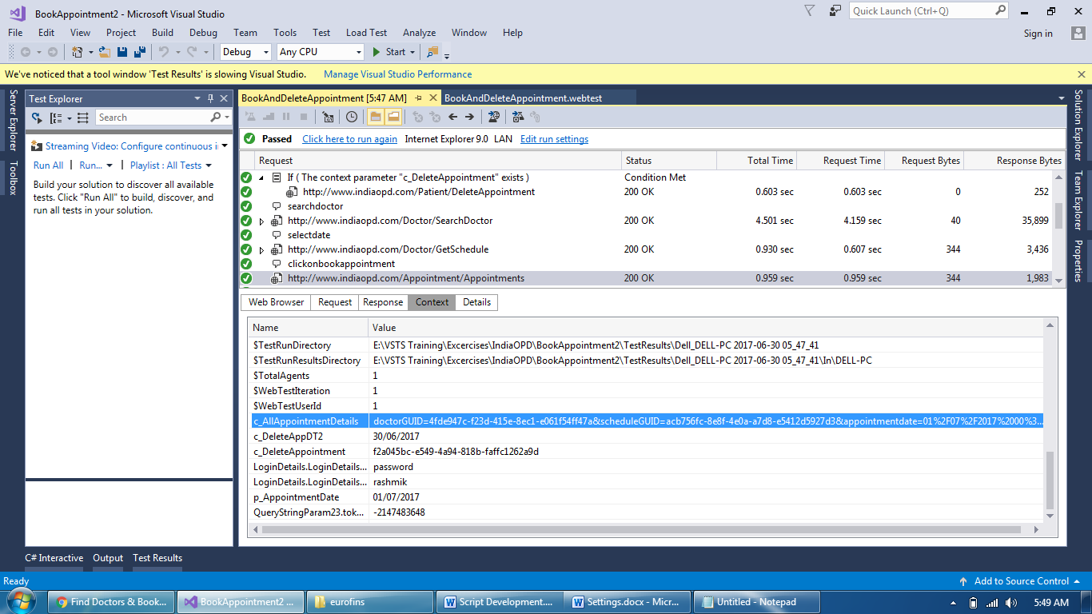
Script Development Screens
Verify if it worked and captured entire row of value

Slide 51
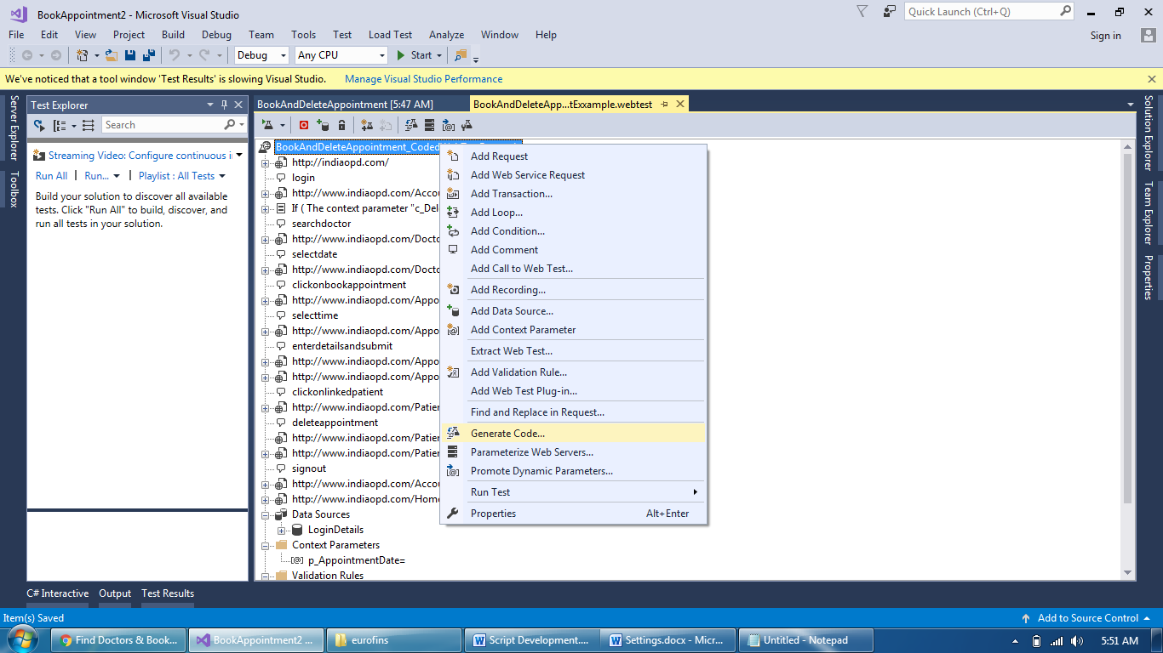
Script Development Screens
Save As your script and Generate Code

Slide 52
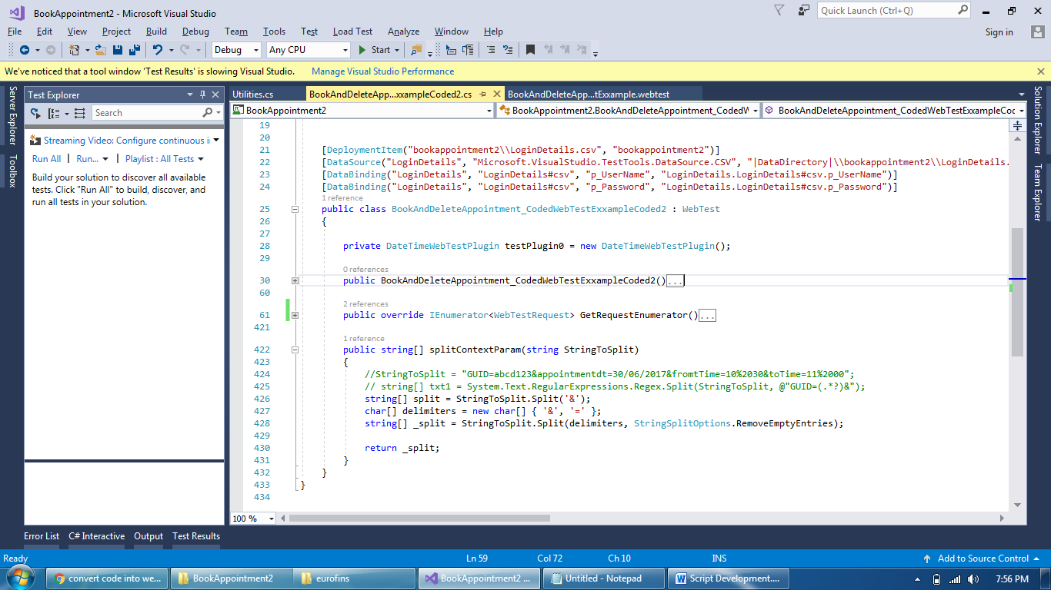
Script Development Screens
Add your logic to extract values in coded web test

Slide 53
Script Development Screens
Code to call a method and pass valid input\output data
Values parameterized in Coded Web Test
Actual Logic in a separate method
string[] txtTemp = System.Text.RegularExpressions.Regex.Split(this.Context["c_AllAppointmentDetails"].ToString(), @"&slotDuration");
string[] splited = splitContextParam(txtTemp[0]);
request7.QueryStringParameters.Add("scheduleGUID", splited[1], false, false);
request7.QueryStringParameters.Add("appointmentdate", splited[3], false, false);
request7.QueryStringParameters.Add("fromTime", splited[5], false, false);
request7.QueryStringParameters.Add("toTime", splited[7], false, false);
public string[] splitContextParam(string StringToSplit)
{
//StringToSplit = "GUID=abcd123&appointmentdt=30/06/2017&fromtTime=10%2030&toTime=11%2000";
// string[] txt1 = System.Text.RegularExpressions.Regex.Split(StringToSplit, @"GUID=(.*?)&");
string[] split = StringToSplit.Split('&');
char[] delimiters = new char[] { '&', '=' };
string[] _split = StringToSplit.Split(delimiters, StringSplitOptions.RemoveEmptyEntries);
return _split;
}

Slide 54
Script Development Screens
Passed and failed some times, need to parameterize mobile number as well ☺
Code to parameterize mobile number in Coded Web Test
[DataBinding("LoginDetails", "LoginDetails#csv", "p_MobileNo", "LoginDetails.LoginDetails#csv.p_MobileNo")]
request8Body.FormPostParameters.Add("Patient.Mobile", this.Context["LoginDetails.LoginDetails#csv.p_MobileNo"].ToString());

Slide 55
Best of Luck

